Slide 1
Cyber Bullying Classification
By -
Abhijeet Patil
Abhinav Rahate
Akshay Mukundwar
Bharat Solanki
Rohit Dhuratkar
Soham Wani

Slide 2
Problem Statement
One of the major challenges in identifying cyberbullying or cyber-aggressive comments is to detect a sender’s tone in a particular text message, email or comments on social media, since what a person may consider to be a joke, may act as a hurting insult to another.

Slide 3
Objective
To Predict if the given tweet is Cyber-Aggressive or Non Cyber-Aggressive
Use various ML algorithms to build prediction models, evaluate the accuracy and performance of these models.

Slide 4
Data Description
The dataset has 20001 items and all have been manually labeled.
The labels are divided into following 2 categories:
1 (Cyber-Aggressive)
0 (Non Cyber-Aggressive)

Slide 5
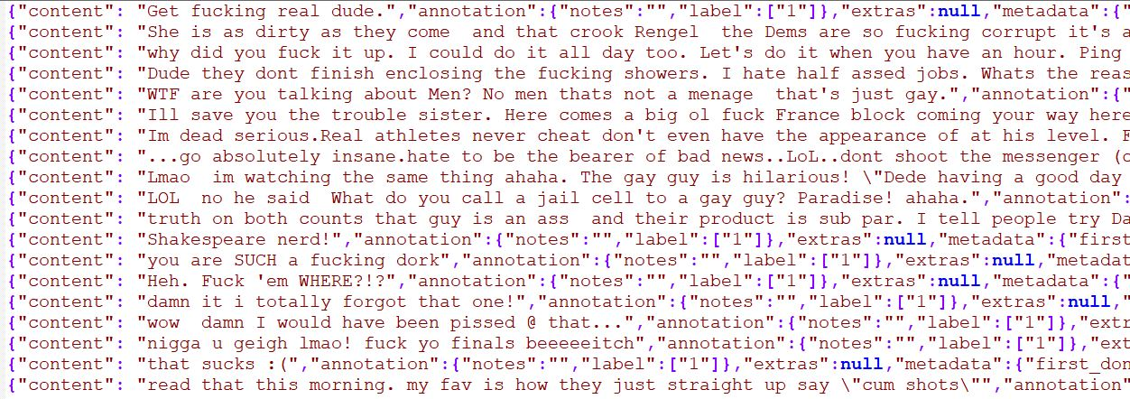
DATASET
Dataset is in json format where content is the user comment and label is the target variable

Slide 6
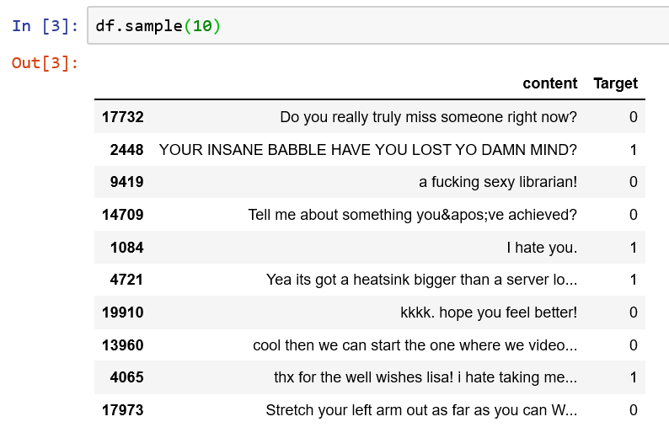
Sample Data

Slide 7
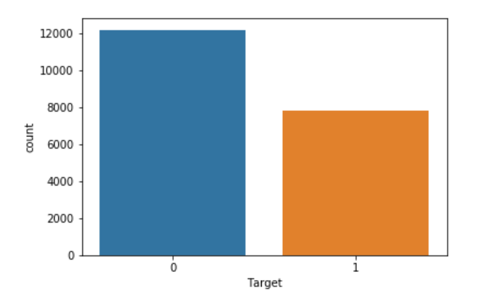
Class Count

Slide 8
Data Pre Processing
This is a process to remove the unwanted words from tweets that does not amount to any emotions.
URLs- Doesn’t signify any sentiment, replace it with blank space.
Stop words- Words such as “a”, “is”, “the”,etc. Doesn’t indicate any sentiment.
UserNames and HashTags- @ symbol before the username and # for topic; both replaced with space.
Stemming - Removing prefix and suffix from the word
Converting all the letters to lowercase.

Slide 9
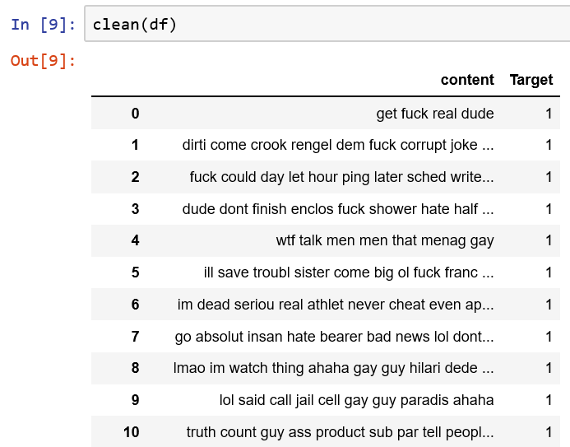
After Pre Processing

Slide 10
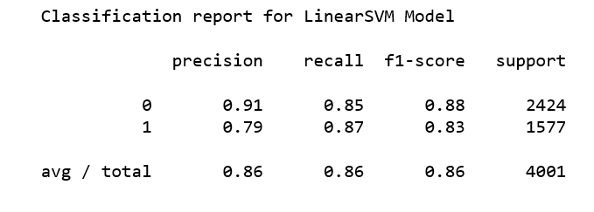
Model Building
Linear SVM:-
Accuracy = 85.98%
v

Slide 11
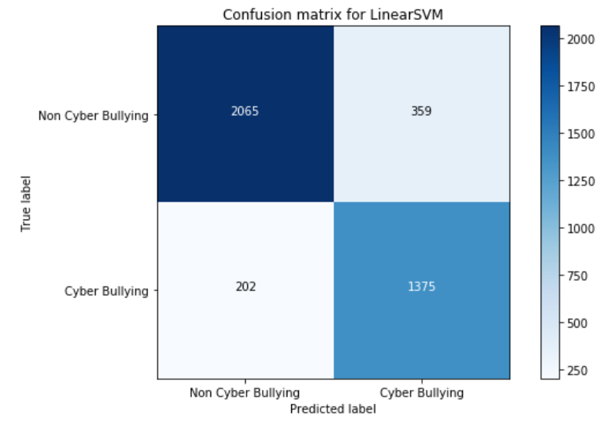

Slide 12
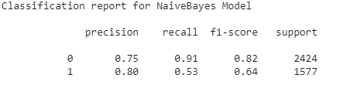
Model Building
2. Naive Bayes
Accuracy = 76.10%

Slide 13
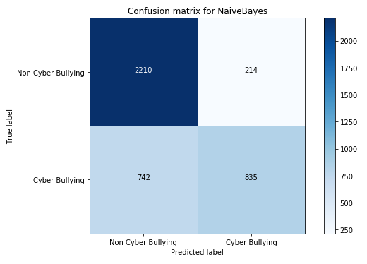

Slide 14
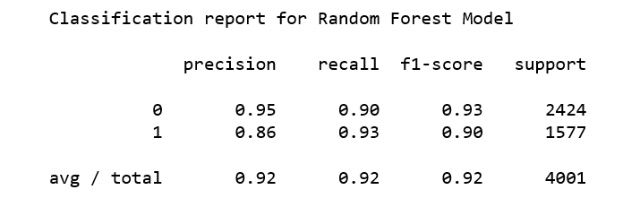
Model Building
3. Random Forest
Accuracy = 91.55%

Slide 15


Slide 16
Thank You

